Slide 1

WEEK 07 drone lecture
Instructor: Yanan Wu
fALL 2025

Slide 2
7.1 drone

Slide 3
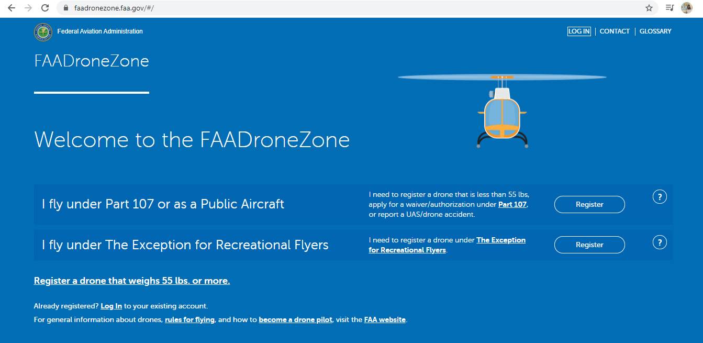
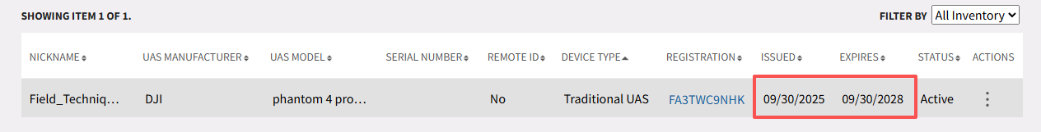
Safety and Regulation
All drones weight more than .55 pounds must be registered
The only real, valid drone registration site is faadronezone.faa.gov
Any other site purporting to ‘help’ or ‘streamlining’ your registration is fake

Slide 4
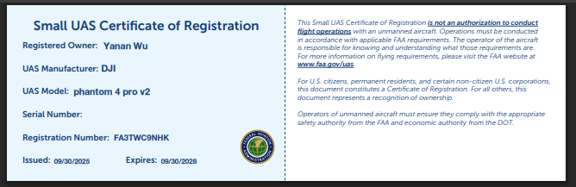
Safety and Regulation
All drones weight more than .55 pounds must be registered
The only real, valid drone registration site is faadronezone.faa.gov
Any other site purporting to ‘help’ or ‘streamlining’ your registration is fake

Slide 5
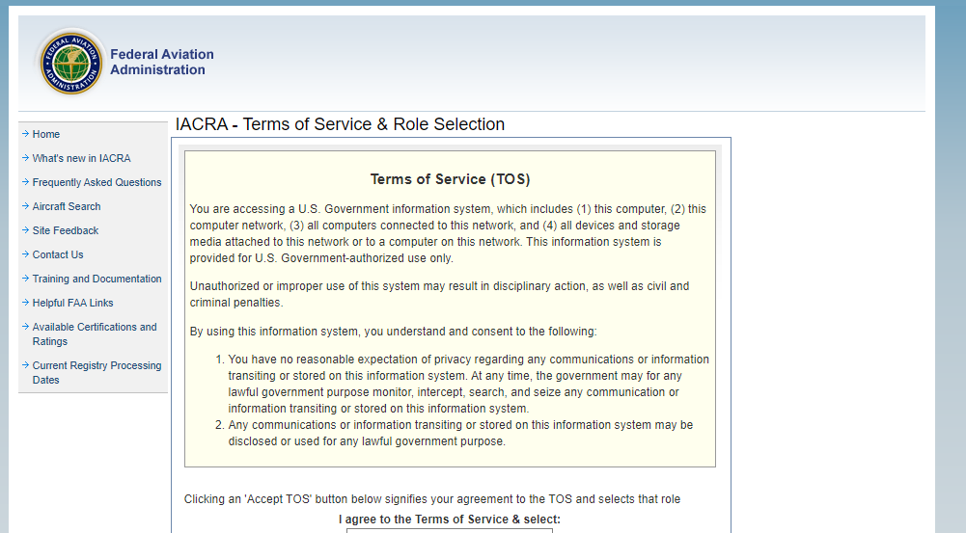

Safety and Regulation
You must have a drone license
Have passed the Part 107 aeronautical knowledge test (Airspace, radio communication, remote operation, weather theory, sectional charts, and so on. 60 Questions, 70% to pass)

Slide 6
Safety and Regulation
You must have a drone license
Are at least 16 years of age
Have been vetted by the Transportation Security Administration
If you are flying as a hobbyist or as part of a public (government) team, Part 107 does not appl

Slide 7
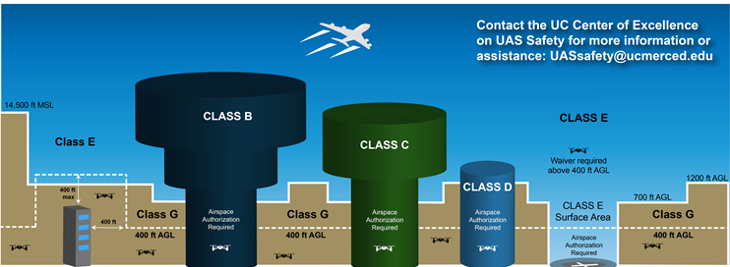
Safety and Regulation
You may need authorization near airports
Controlled airspace: B, C, D, E
Uncontrolled airspace: G
B C, D and E surface area: Authorization required

Slide 8
Safety and Regulation
You may need authorization near airports
Authorization are applied through FAA not less than 90 days before the planned operations

Slide 9
Safety and Regulation
No flying above 400 ft AGL
With some exceptions
If you are already higher than 400 feet (e.g., on top of building), you must remain within 400 feet of the structure in any direction

Slide 10
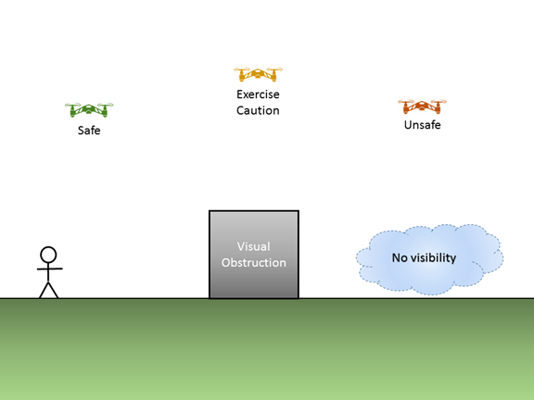
Safety and Regulation
No flying beyond visual line of sight (VLOS)
You must be able to see and assess risk at all times during the flight
If you can’t see the sky around the drone, or the ground below the drone, you’re not within visual line of sight
Visual line of sight (107.31) is defined by being able to:
1.Know the unmanned aircraft’s location;
2.Determine the unmanned aircraft’s attitude, altitude and direction of flight;
3.Observe the airspace for other air traffic or hazards
4.Determine that the unmanned aircraft does not endanger the life or property of another

Slide 11
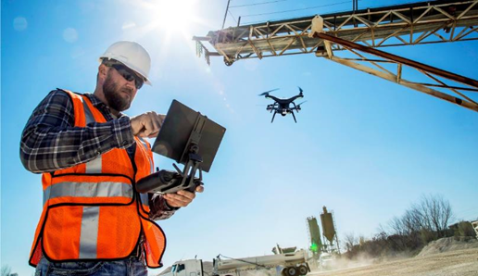
Safety and Regulation
No flying over people
Unless they are part of team
The drone must not put anyone at risk if the drone was to fall

Slide 12
Safety and Regulation
The person operating the drone controls must hold a remote pilot certificate, or be under the direct supervision of, and within close proximity to, someone who does.
A remote pilot must have his/her pilot certificate on his/her person or within easy access while acting as Pilot in Command. A remote pilot must also be able to show 24-calendar month recurrency.

Slide 13
Safety and Regulation
If you change your permanent address you must notify the FAA Airman Certification branch of the new address within 30 days
You may choose to use a Visual Observer (VO) to supplement situational awareness
You must report to the FAA within 10 calendar days of any operation that results in serious injury, loss of consciousness, or property damage of $500 or more

Slide 14
Safety and Regulation
You must give way to any manned aircraft. Do not fly under unmanned balloons
You must only fly one drone at a time
You may not fly faster than 100 mph
You may not operate the drone from a moving aircraft, but you may operate the drone from a moving vehicle if you are flying over a sparsely populated area

Slide 15
Safety and Regulation
You may not fly recklessly or in any way that endangers the life or property of another person
You may not fly if you are tired, mentally or physically impaired
You may not fly if you have consumed alcohol within the prior 8 hours, or with a blood alcohol content of 0.04% or greater

Slide 16
Safety and Regulation
You may fly during civil twilight or night with appropriate anti-collision lighting, visible for at least 3 statute miles
Civil twilight is defined as 30 minutes before official sunrise and 30 minutes after official sunset. Night is defined as the period between the end of evening civil twilight and beginning of morning civil twilight
Night flight may need waiver and has additional requirement of passing a Part 107 after 04/05/2021

Slide 17
Safety and Regulation
You must have 3 statute miles of visibility
You must remain at least 500 feet below and 2,000 feet horizontally from clouds
You may not fly anywhere that may interfere with the operation of an airport. This includes, but is not limited to, approach corridors, traffic patterns, taxiways, runways, and helipads
The drone plus additional cargo may not weigh 55 pounds or more

Slide 18
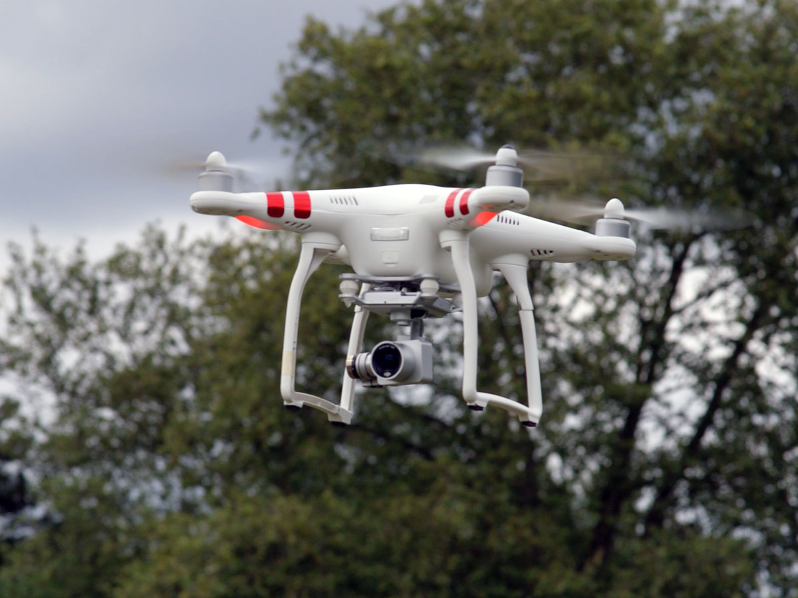
Drone
DJI Phantom 2
Is basic and somewhat antiquated
Cost < $300 (if you can find them)
Have smart battery
Have approximately 20 minutes of flight time
DJI products are prohibited for most federal agencies

Slide 19
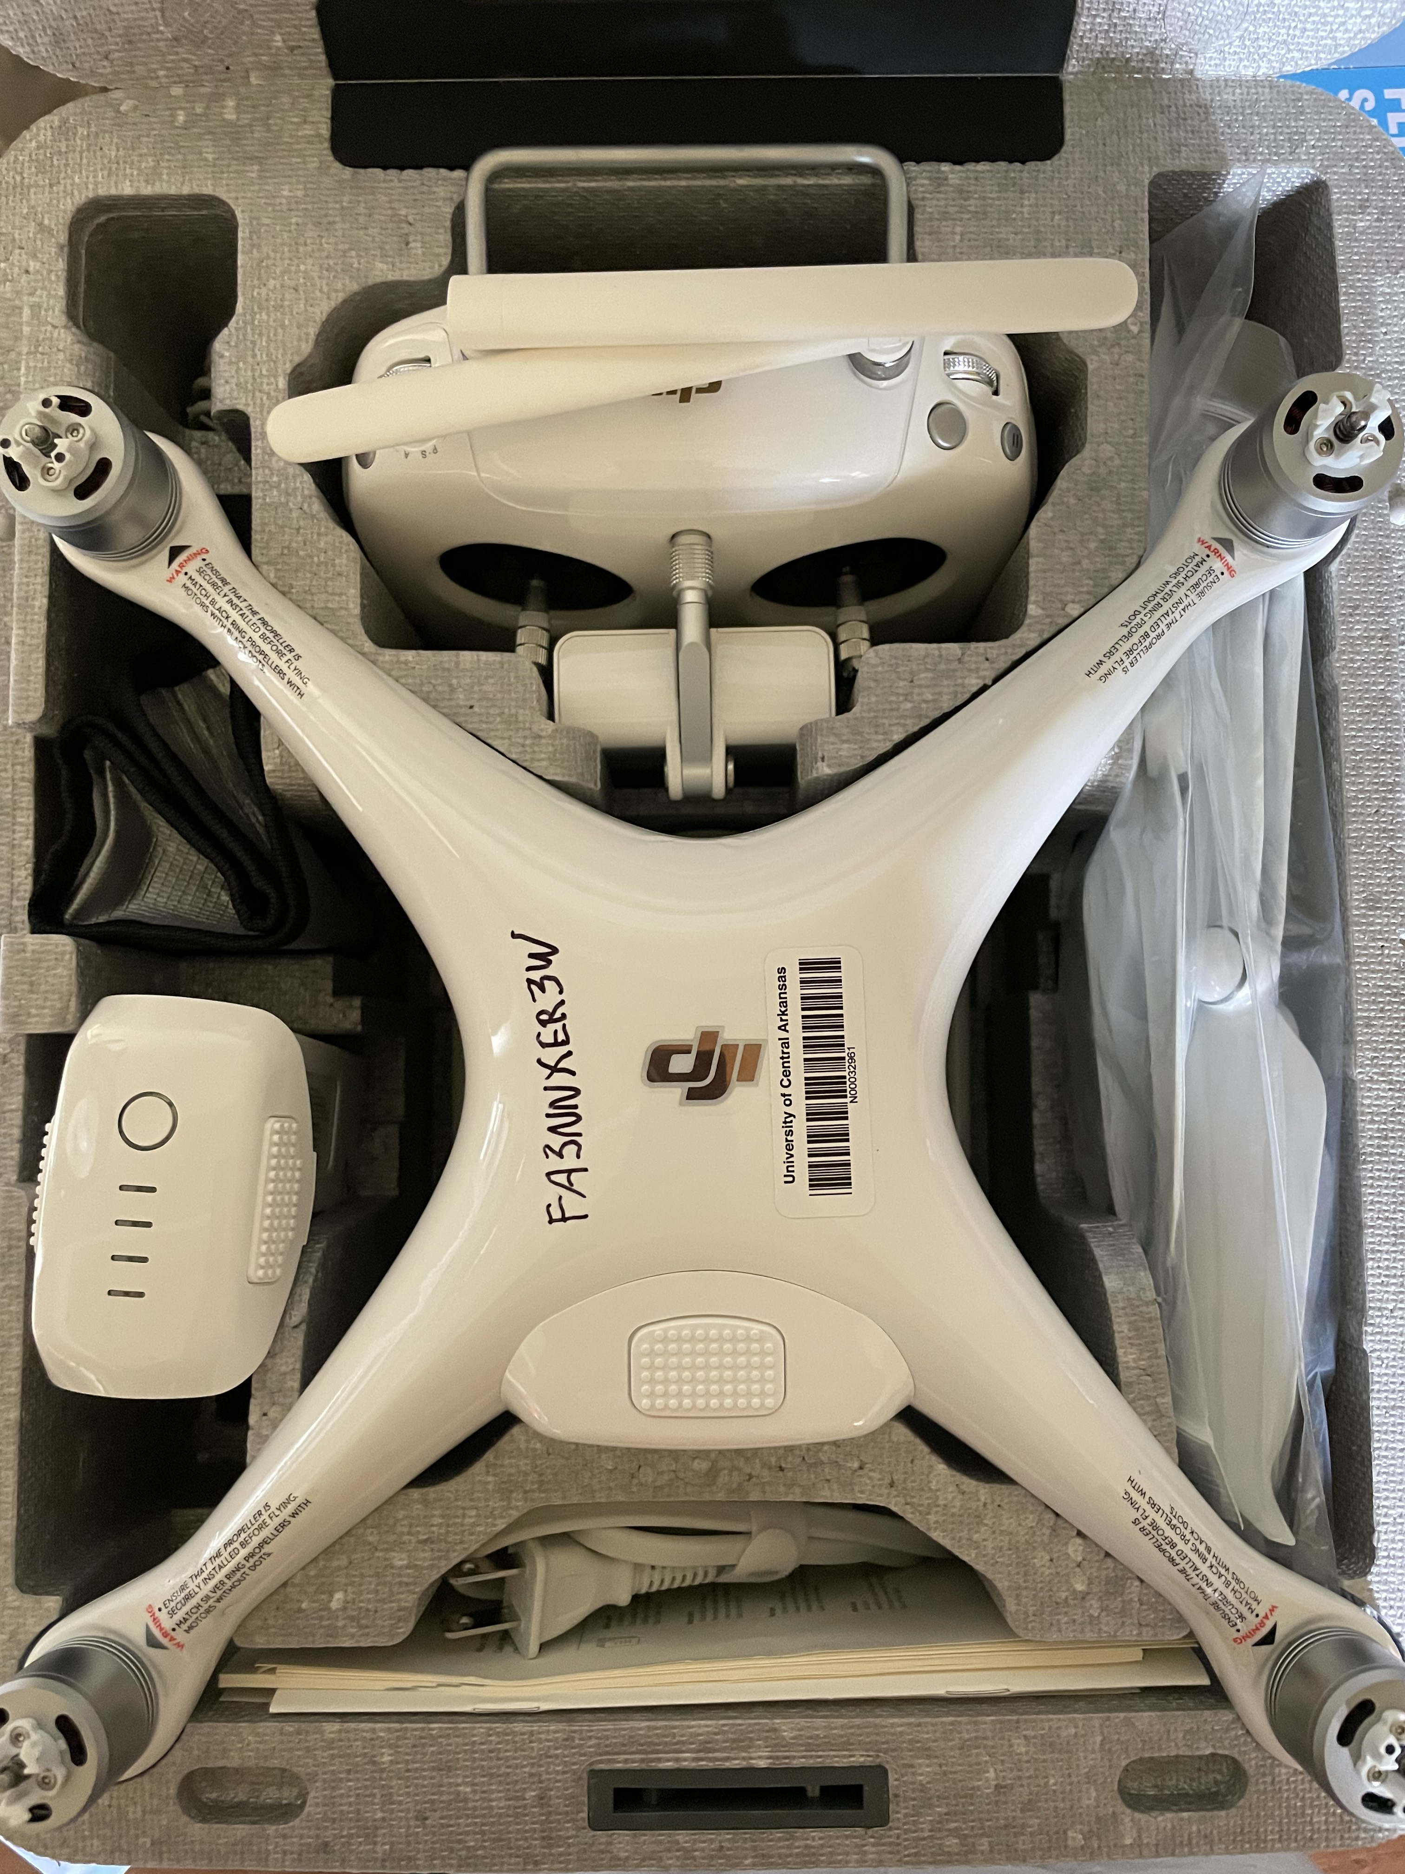
Drone
DJI Phantom 4 Pro
Weight 1,380 g
Cost $1,599
Have smart battery
Have approximately 28 minutes of flight time
Max transmission distance: 2.2 mi to 3.1 mi
Satellite positioning systems: GPS/GLONASS

Slide 20
Drone preflight checking
Conduct a preflight inspection of the drone to make sure it is in a condition for safe operation
Check for all Notices To Airmen (NOTAMs) to determine if there are any applicable airspace restrictions
Conduct an assessment of the operating environment
Obtain local weather information
Obtain local airspace information and restrictions
Locate and access persons and property in the area, as well as all other potential ground hazards
Ensure that all control links between the control system and the drone are working properly
Ensure there is sufficient power to continue flight operations to a normal landing
Notes:
A NOTAM is a notice containing information essential to personnel concerned with flight operations but not known far enough in advance to be publicized by other means. It states the abnormal status of a component of the National Airspace System (NAS) – not the normal status

Slide 21
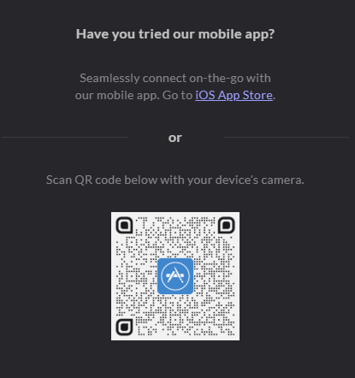
Drone preflight checking
Download and Install the App
Search three locations:
Your current location
Bill and Hillary Clinton National Airport
Downtown Grill, Conway
https://www.faa.gov/uas/getting_started/b4ufly
https://portal.airspacelink.com/
Notes:
A NOTAM is a notice containing information essential to personnel concerned with flight operations but not known far enough in advance to be publicized by other means. It states the abnormal status of a component of the National Airspace System (NAS) – not the normal status

Slide 22

Drone preflight checking
Download and Install the App
Create an account
GEO Zones
DJI GO 4
Notes:
A NOTAM is a notice containing information essential to personnel concerned with flight operations but not known far enough in advance to be publicized by other means. It states the abnormal status of a component of the National Airspace System (NAS) – not the normal status

Slide 23
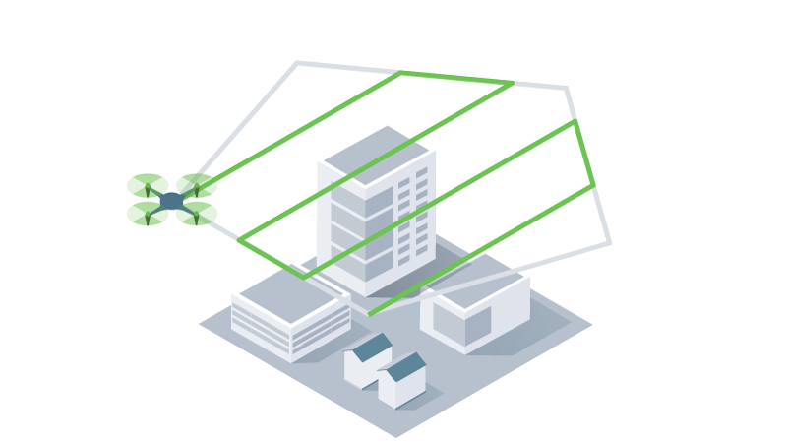
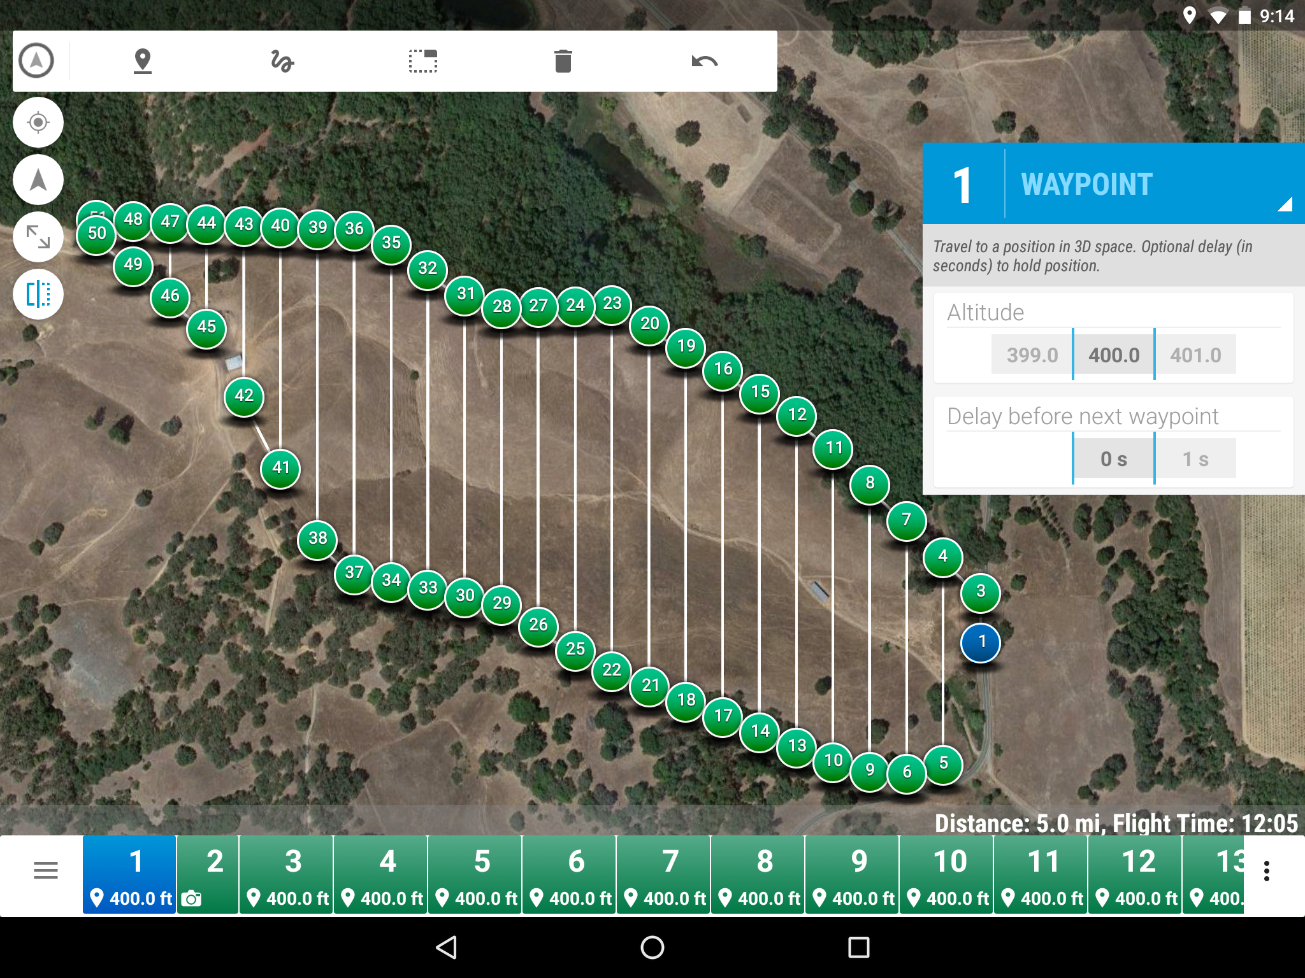
Mission Plan
Better data
Same altitude, fly speed, and so on
Replicate missions
This is helpful with time series analyses!
It’s automated
Save time
Drone Camp

Slide 24
Mission Plan
Input into a mission plan
Project goals
Size of study area
Required GSD (Ground Sample Distance)
Ground cover type
Sensor
Platform
Spatial accuracy needs
Drone Camp

Slide 25
Mission Plan
Goals and Aspirations
sensor type
preferred GSD
size of study area
preferred aircraft
repeatability
Drone Camp

Slide 26
Mission Plan
Logistic and Constraints
airspace & local permissions
site access & launch points
time available for field work
flight time, # batteries
wind & weather
sun & shadows
data processing resources
Drone Camp

Slide 27
Mission PlanW
Rules of Thumb
Visibility
Fly at least double the height of trees
Large areas
Plan your mission so you are flying back toward yourself
Consecutive flights need begin where the last one ended
Challenging terrain
Launch from the highest altitude possible
Challenging surface cover
Photogrammetry of whipping grass in the wind is most difficult with low altitude flights
Drone Camp

Slide 28
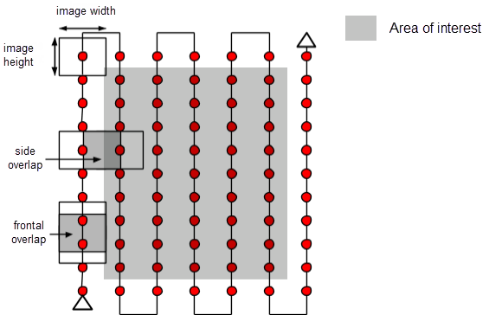
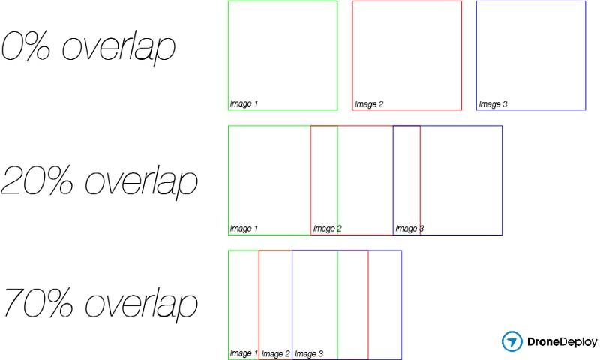
Mission Plan
Overlap
Minimum
75% frontal overlap
60% side overlap
BUT this depends
Higher overlap is needed for thermal imagery and high relief terrain
Drone Camp

Slide 29
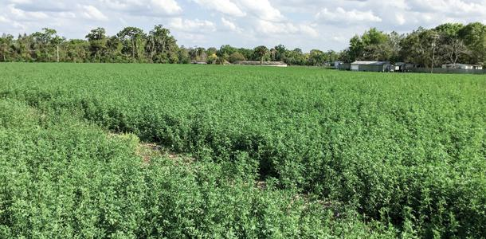
Mission Plan
Overlap
Agriculture and dense vegetation
85% frontal overlap
80% side overlap
Aim for 5-10 cm/pixel GSD
Drone Camp

Slide 30
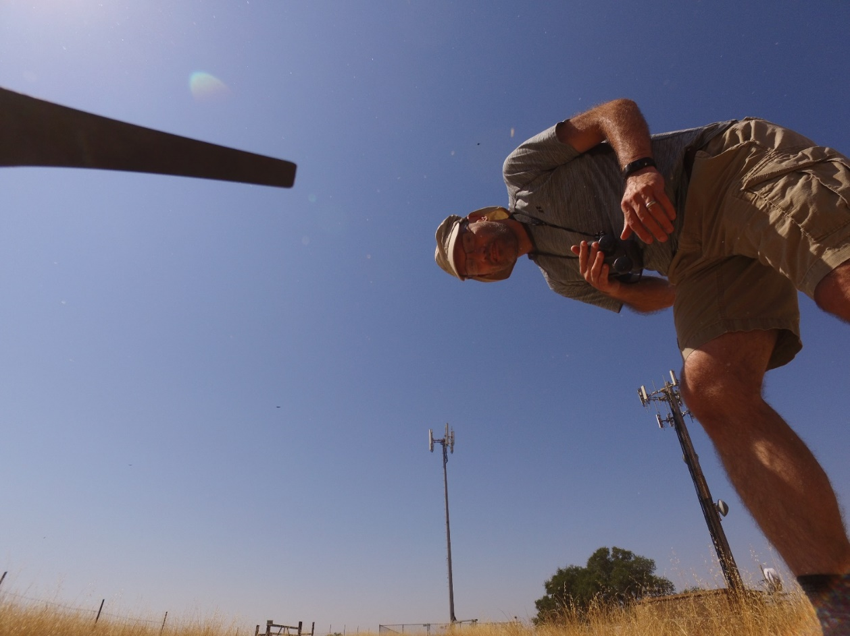
Mission Plan
Select a launch point
Launch high for safety & better GPS reception
Flat is good
Level is even better
Away from obstacles
Sun at your back
Downwind from AOI (area of interest)
Minimize time between flights
Use a landing pad in dusty environments
Drone Camp

Slide 31
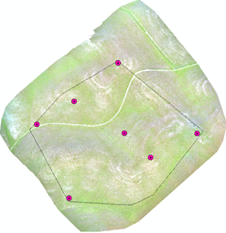
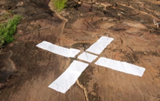
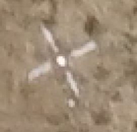
Mission Plan
Ground Control Points
Need precise geo-registration for overlays
Need to mosaic multiple flights over complex topography
Drone Camp

Slide 32





Mission Plan
Mission Planning Apps
Pix4D Capture
Precision Flight
DroneDeploy
DJI Pilot
Drone Camp

Slide 33



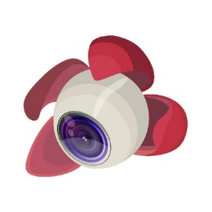

Mission Plan
Mission Planning Apps
DJI Ground Station Pro
Map Pilot
Drone Harmony
Litchi
QGroundStation
Drone Camp

Slide 34
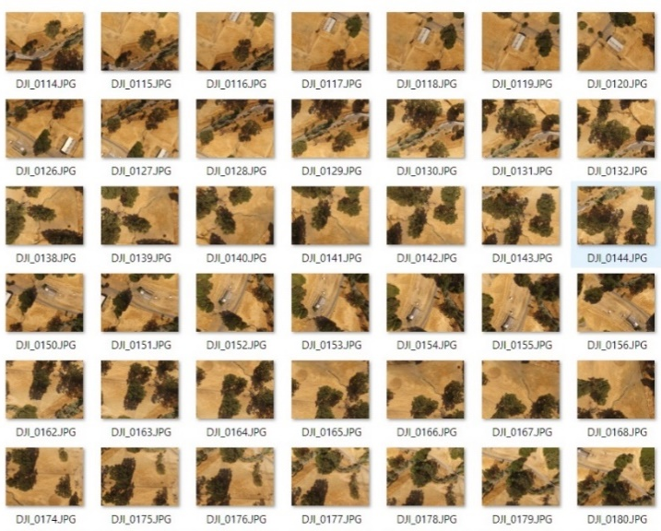
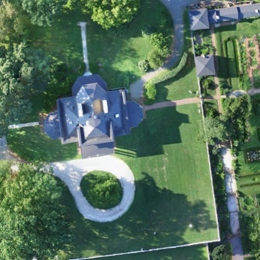
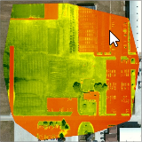
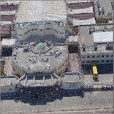
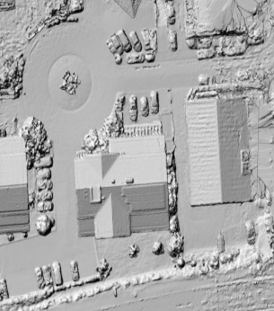
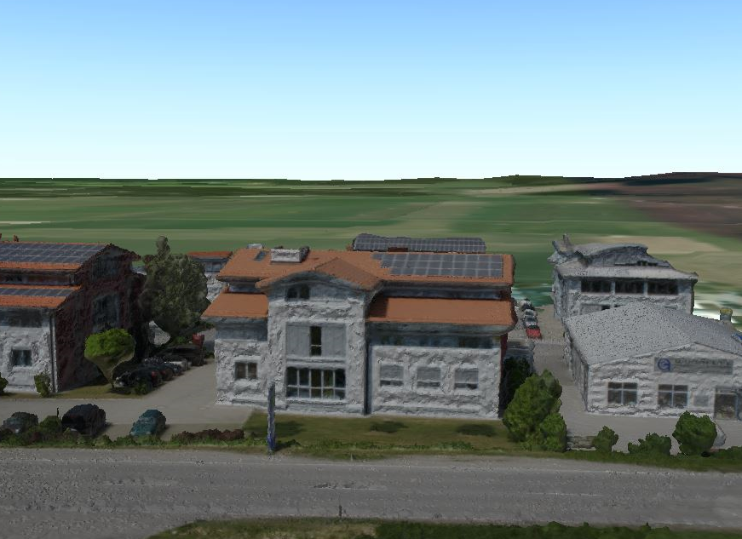
Mission Plan
Outputs
Orthomosaic
Veg Indices
Point Cloud
DSM
Textured Mesh
Drone Camp

Slide 35
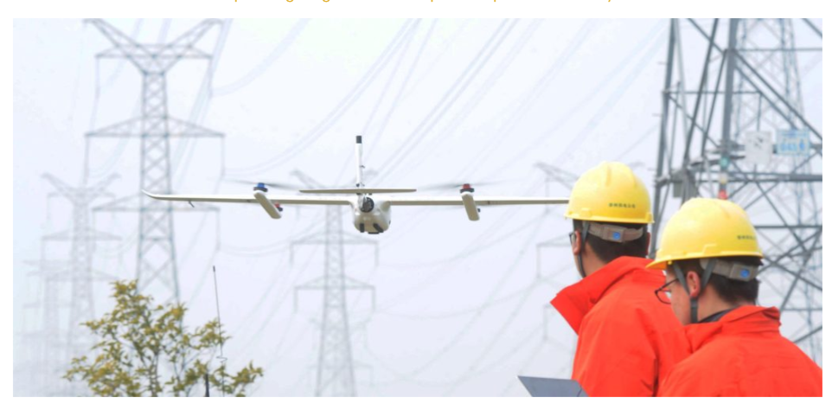
Application of Drone
Power inspection

Slide 36

Thank you!

